Slide 1
Day 27
Visibility Graphs

Slide 2
Introduction
if we have to frequently plan paths on a static environment then it makes sense to use a data structure that supports efficient planning of subsequent paths
e.g., visibility graph
nodes correspond to vertices of polygonal obstacles
edges correspond to paths between nodes

Slide 3
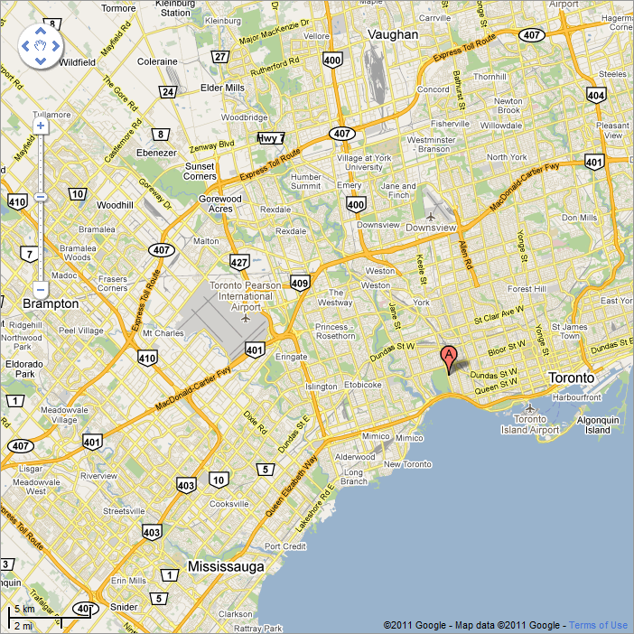
Roadmaps
consider the highways (in orange) in the GTA

Slide 4
Roadmap
definition:
A union of one-dimensional curves is a roadmap (RM) if for all starting points (q_{start}) and goal points (q_{goal}) in freespace (Q_{free}) that can be connected by a path the following properties hold:
Accessibility
there exists a path from q_{start} to some q'_{start} ∈ RM
i.e., the robot can reach the roadmap from the start point
Departability
there exists a path from q'_{goal} ∈ RM to q_{goal}
i.e., the robot can depart the roadmap to reach the goal point
Connectivity
there exists a path in RM from q'_{start} to q'_{goal}
i.e., there is a path on the roadmap connecting the start and depart points

Slide 5
Visibility Graph
defined for 2D space with polygonal obstacles
a graph where
nodes
{q_{start}, q_{goal}, and vertices of all obstacles }
edges
connect all pairs of nodes n_{i} and n_{j} that are visible to one another

Slide 6
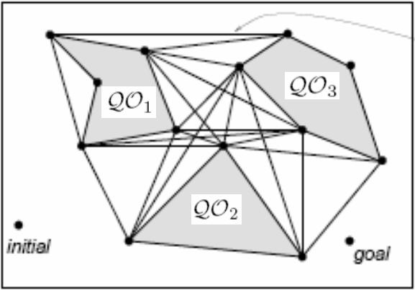
Visibility Graph
contains the shortest path between the start and goal
* normally the start and goal points are included in the graph

Slide 7
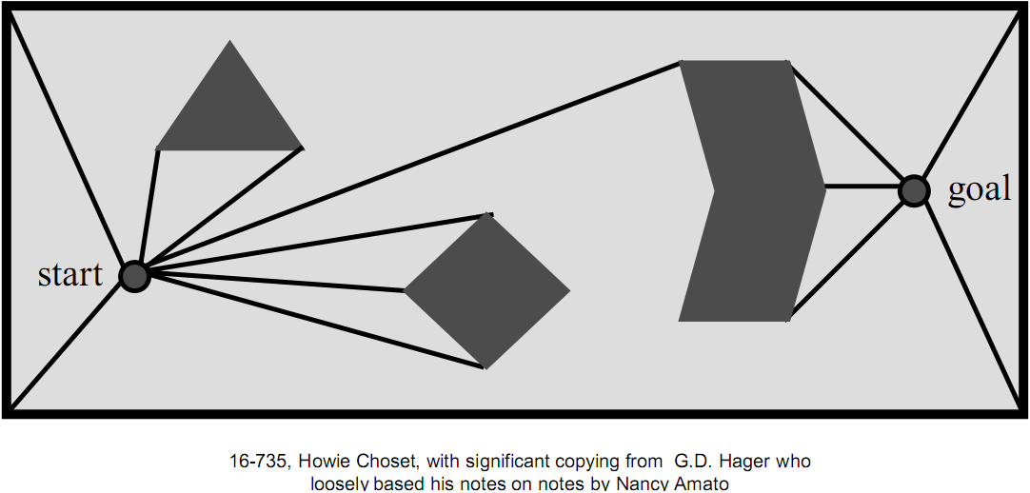
Visibility Graph Construction
start by drawing lines of sight from start and goal to all visible vertices

Slide 8
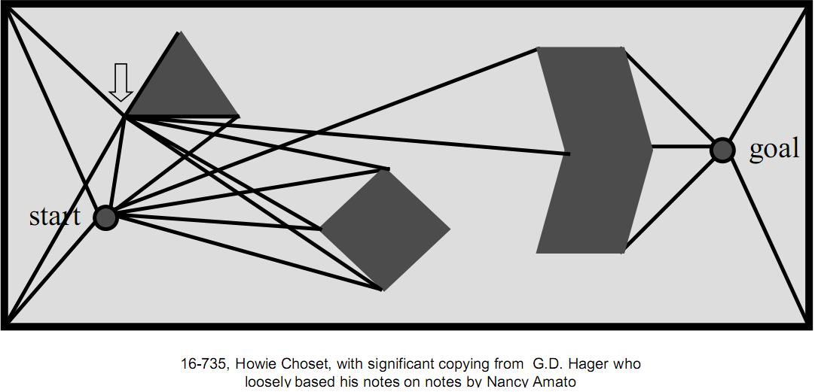
Visibility Graph Construction
next, draw lines of sight from every vertex of every obstacle
edges of obstacles are also lines of sight

Slide 9
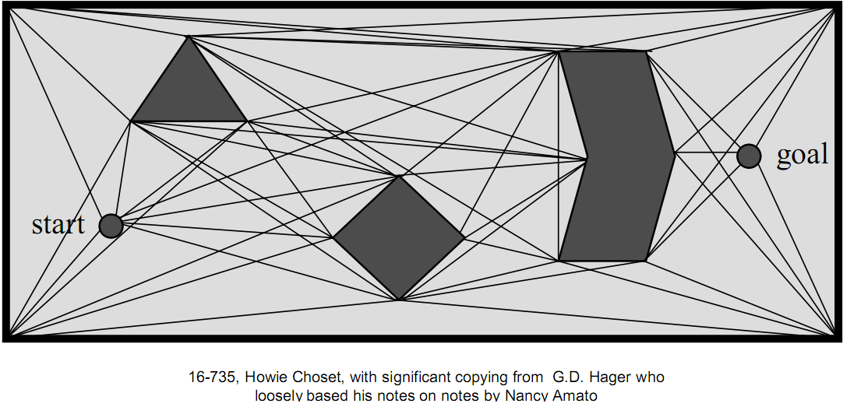
Visibility Graph Construction
repeat until done

Slide 10
Visibility Graph Construction
the algorithm described is O(N ³) where N is the number of vertices

